Slide 1
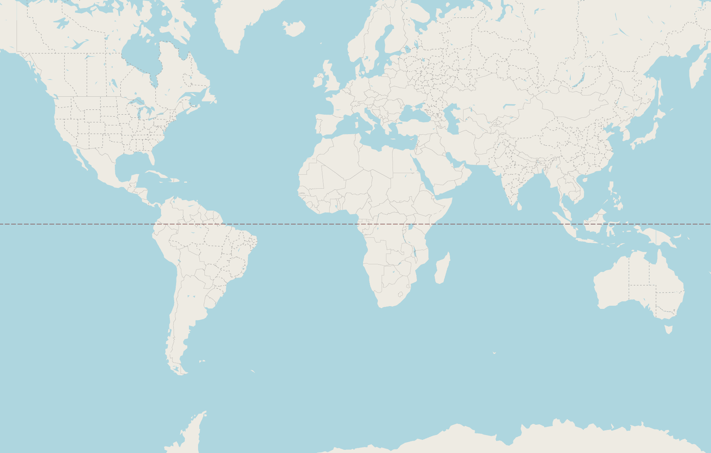
WHEREABOUTS ?
Rachel, Adam, Caroline, James

Slide 2
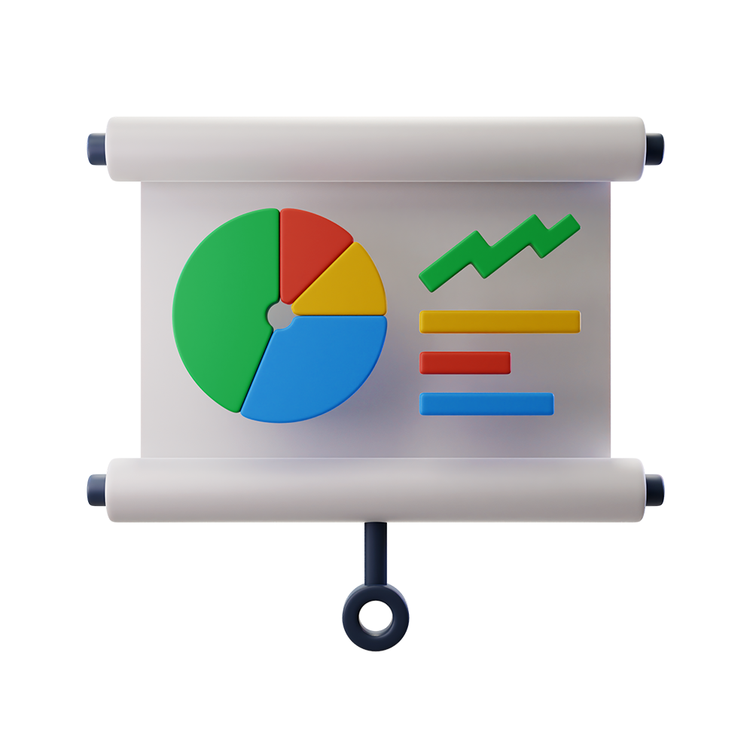
Ambitions
User experience
Team dynamic
Production environment
Aspects of development
Technology

Slide 3
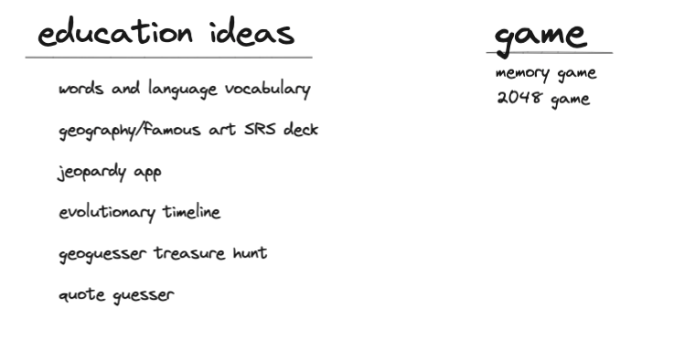
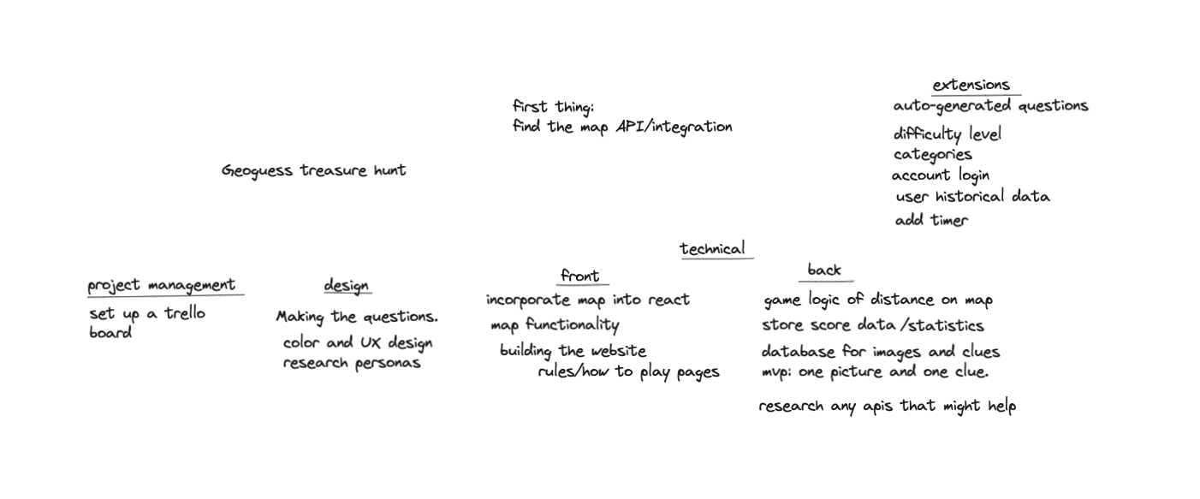
Discovery Phase
Notes:
Flung out ideas - all didnt want to do stocks or carbon footprint brief
Agreed on one idea at the end of Thursday (day 1)
Tried the map to see our idea was doable
Geoguesser & on the tracks

Slide 4
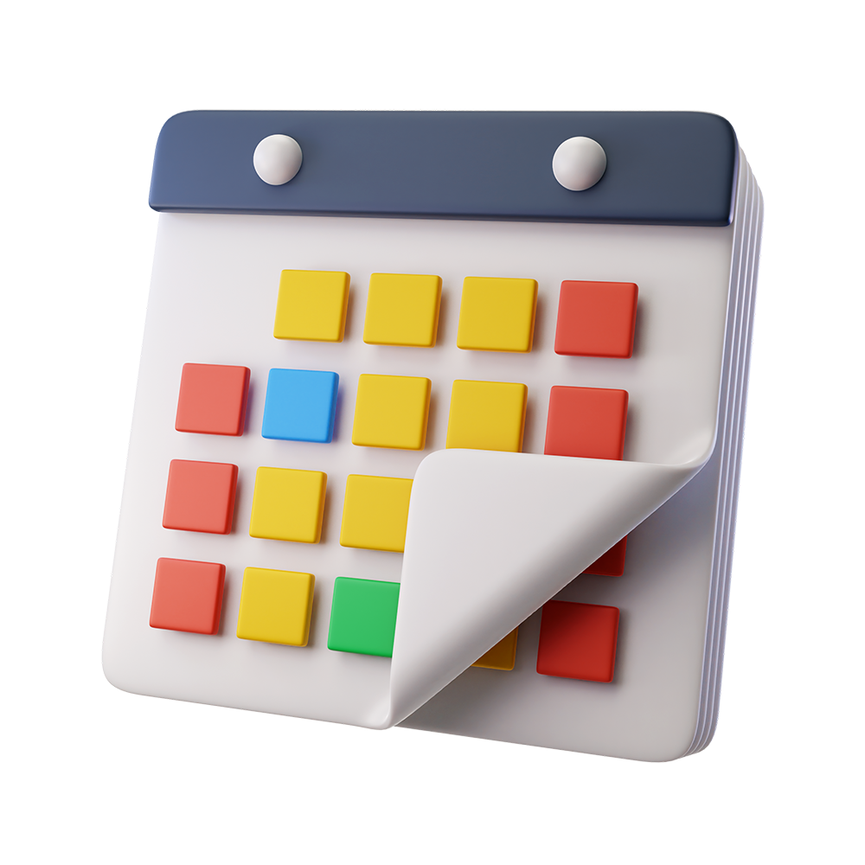
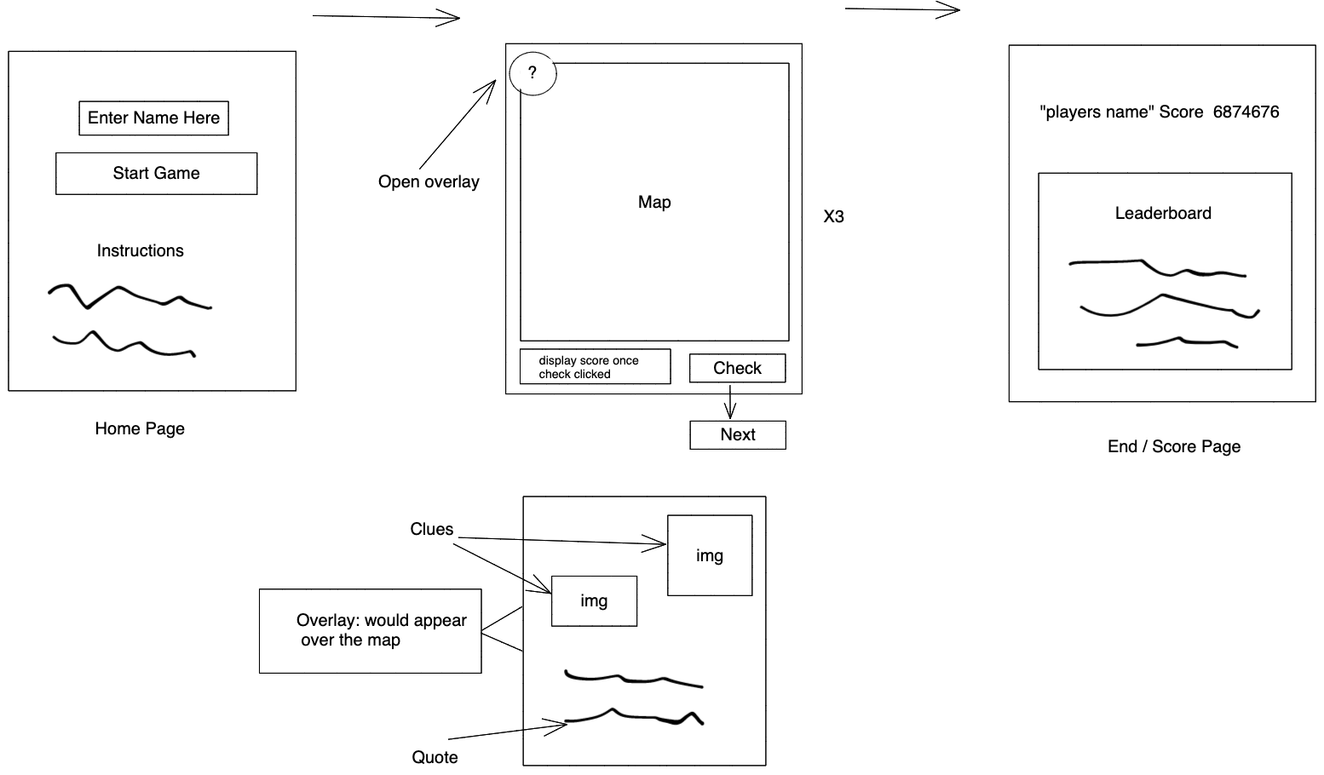
Planning
Initial rough wireframes to flesh out flow of pages and users experience

Slide 5
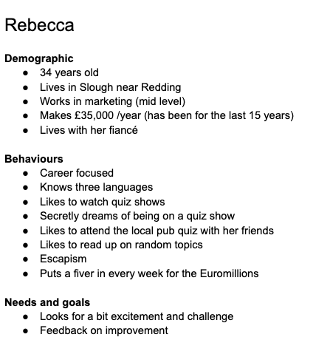
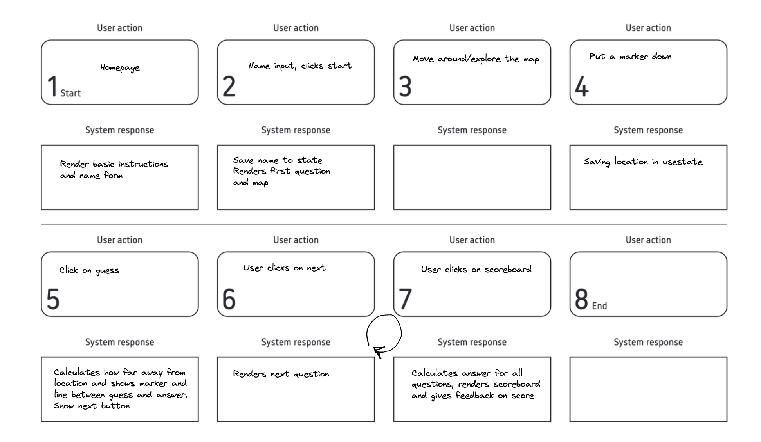
Planning
UX - Created Persona and User Journey to figure out our target market and their ideal experience

Slide 6
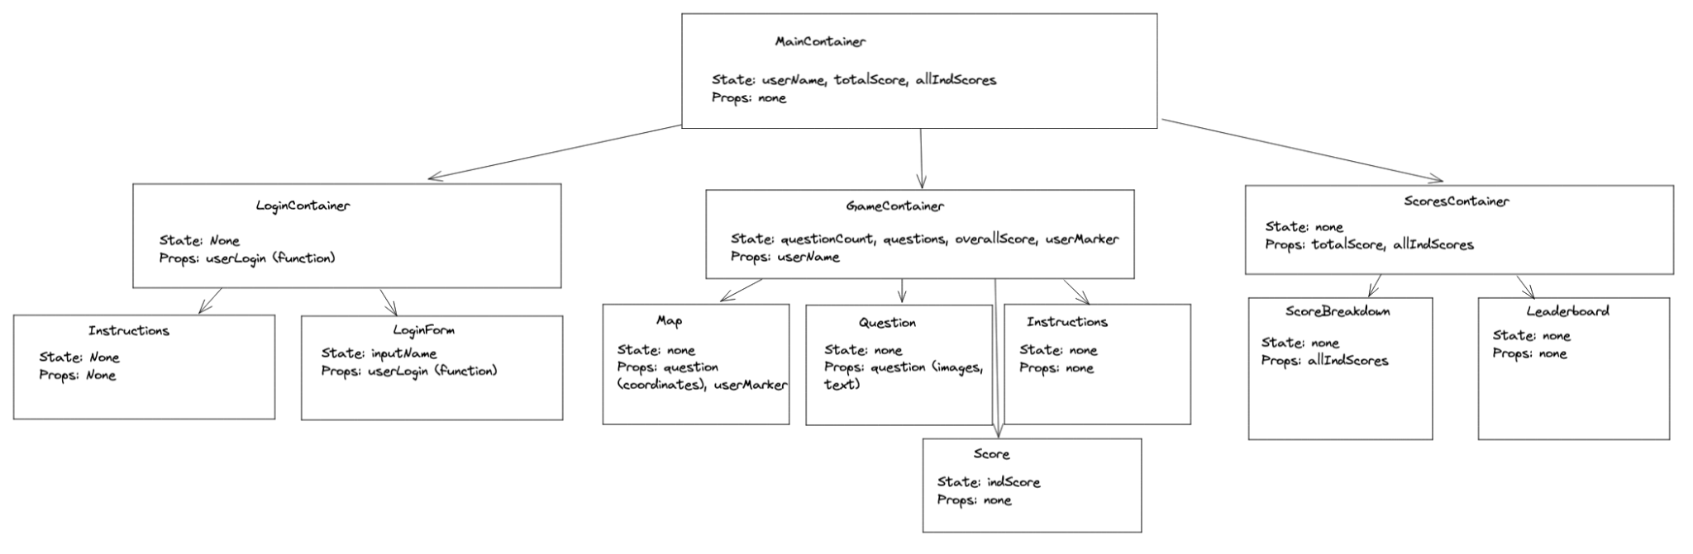
Planning
Container and Component tree to see where props and state should go

Slide 7
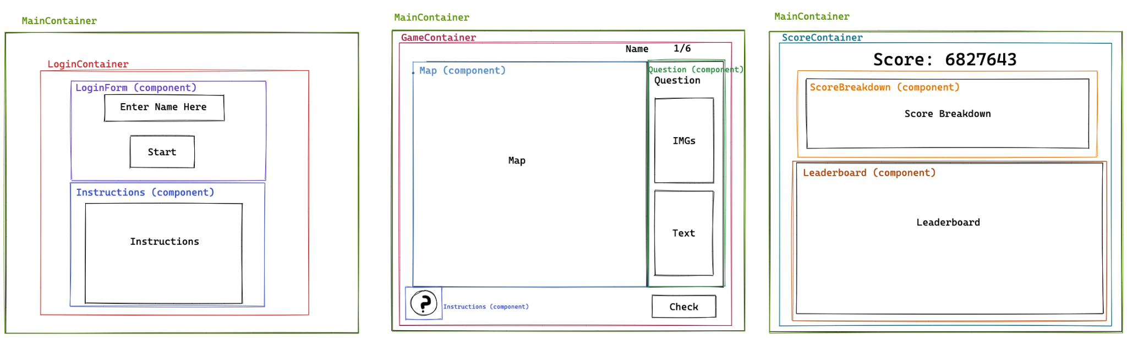
Planning
Container and Components as overlays on wireframes

Slide 8
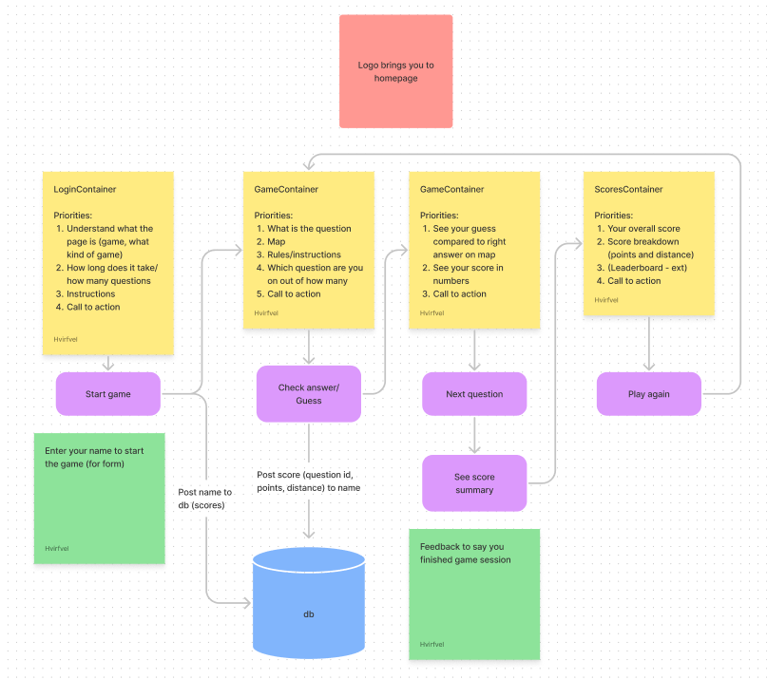
Planning
Combined Containers and app functionality with User Journey to bring together UX design with Software Implementation

Slide 9
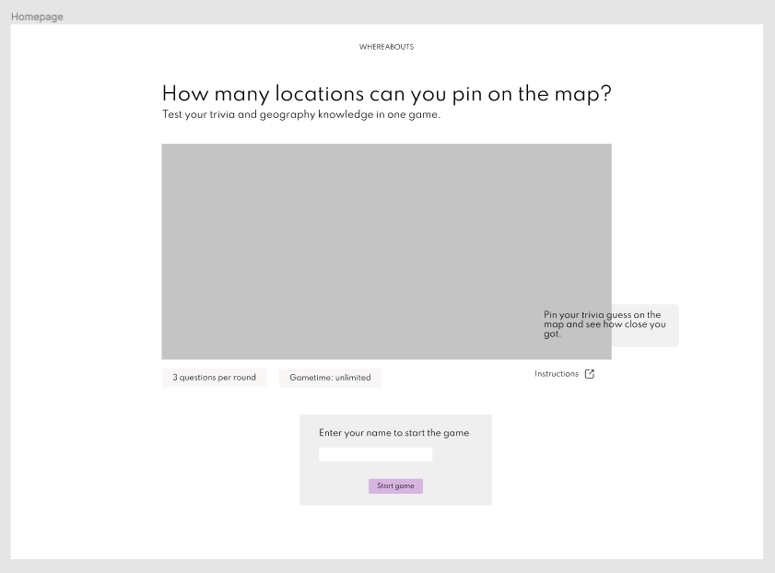
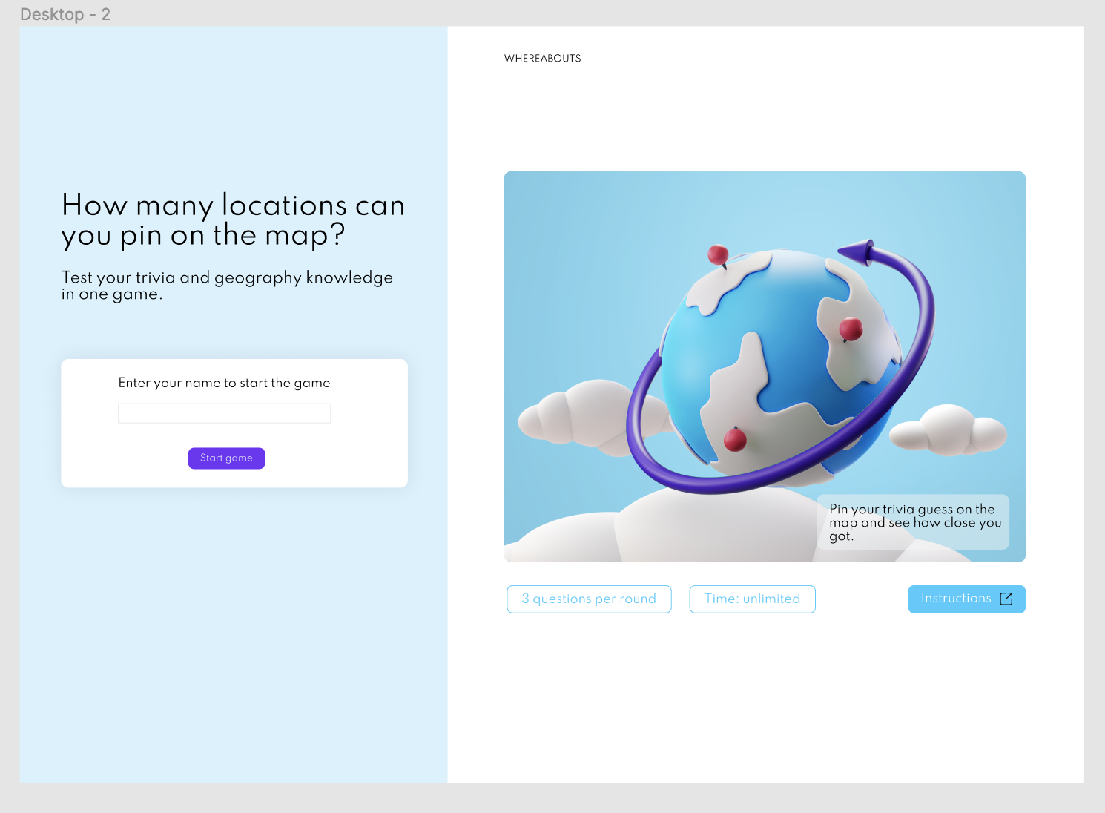
Mockups
Grayscale to coloured

Slide 10

LET’S PLAY
WHEREABOUTS?

Slide 11

Working as a team
Planning
Lots of communication
Workflow
Git branches
Paired programming
Notes:
Planning together/Agreeing on project direction
Lots of communication
Kept to a strict review and merge process
Adopted Agile workflow and used a trello board.
Maintained the work/life balance inline with our goal of keeping a realistic production environment.
Git branches
Paired programming within a team, being in a four we got to alternate our pairs and work on different problems together

Slide 12

Problems and solutions
Who does what?
Size of stories
CSS being CSS
Infinite re-renders
Asynchronicity is fun
Notes:
Infinite re-renders - applying useEffect to apply render elements at specific times
JS asynchronicity is fun.
CSS being CSS
Starting out - who does what, size of stories
Infinite re-renders - applying useEffect to apply render elements at specific times
JS asynchronicity is fun.

Slide 13
What we learned
A lot!
Git workflow
JS - Async
Trello
React
API
Realisation
Passive/group learning
Notes:
Git - branching, merging & conflicts
Async issues, working with timing and ordering of functions useEffect
Using Trello board as a group.
React - consolidation to the point of comfort
Using the terminal.
API practice with Insomnia
The practice of realising an idea. We MADE a thing.
Passive/group learning

Slide 14
What we would do next time/extensions
Accessibility and gameplay settings
Fix question database
UI Enhancements
More questions
Account system
Expansion of game concept
Notes:
Accessibility and gameplay settings
Add a time limit
Number of questions selection
difficulty setting
technical
fix question api to request data from database
testing mode
More questions
create a question generator
Accounts
setting up an account system to eliminate double questions and record scores
Expansion of game concept
Nightsky mode
Categories

Slide 15
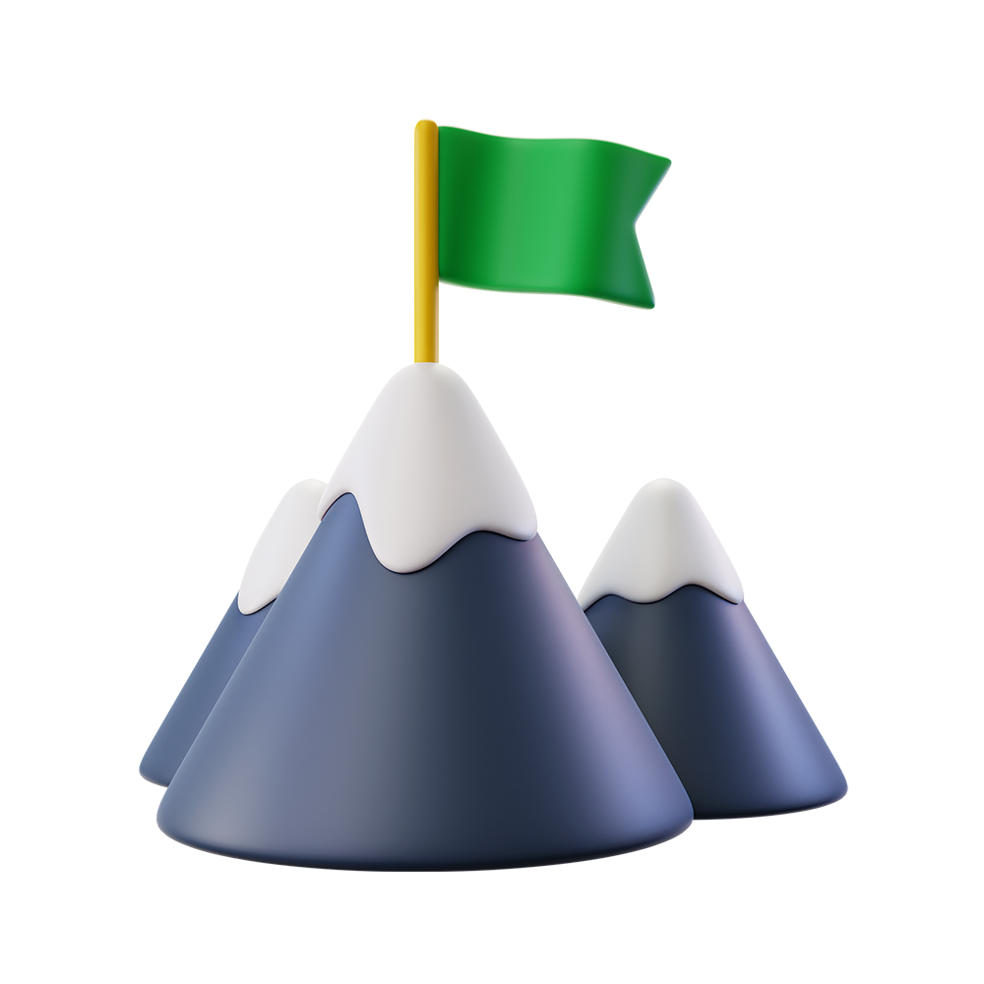
Most proud of
Notes:
Our sweet design!
Fun to play
Growth in confidence
WE made a thing
Game functionality
A good discovery phase and good planning phase.
No regrets
A good work life balance
efficient

Slide 16
235 commits
66 merges
4 members
1 app

Slide 17
QUESTIONS?

